Slide 1
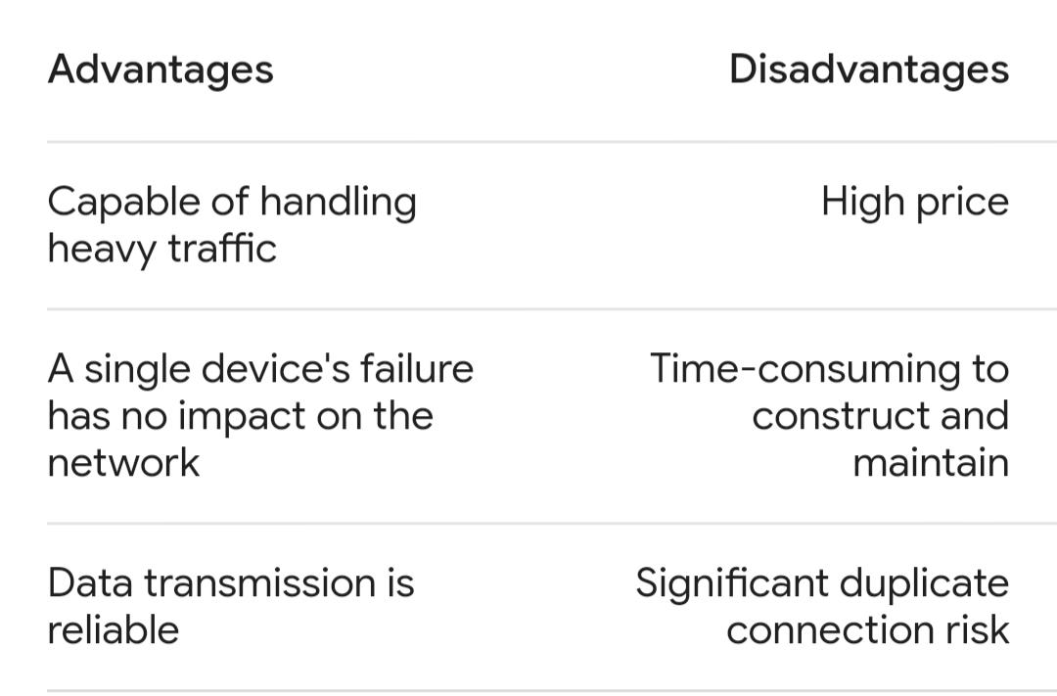
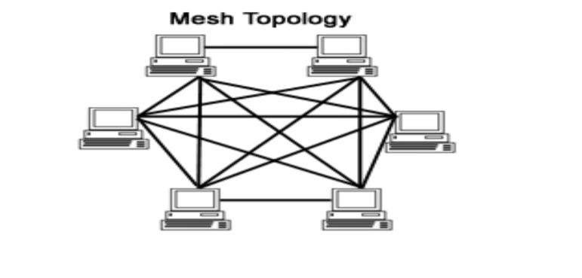
MESH TOPOLOGY
------------------------------------
Mesh topology is a network configuration where devices are interconnected in a decentralized manner.Even if one of the connections goes down, by using other connections a node can be alive on a network.

Slide 2
How to use mesh topology in Cisco packet tracker
Step 1: First, open the Cisco packet tracer desktop and select the devices given below: S.NO Device Model name 1. PC PC 2. Switch PT-switch
Add ip adress
S.NO Device IPv4 Address Subnet Mask 1. pc0 192.168.0.1 255.255.255.0 2. pc1 192.168.0.2 255.255.255.0 3. pc2 192.168.0.3 255.255.255.0 4. pc3 192.168.0.4 255.255.255.0
Step 2: Configure the PCs (hosts) with IPv4 address and Subnet Mask according to the IP addressing table given above. To assign an IP address in PC0, click on PC0. Then, go to desktop and then IP configuration and there you will IPv4 configuration. Fill IPv4 address and subnet mask.

Slide 3
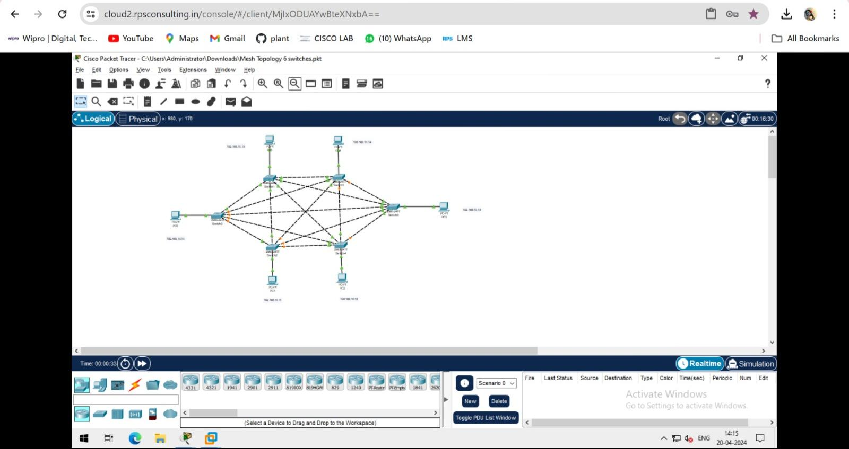
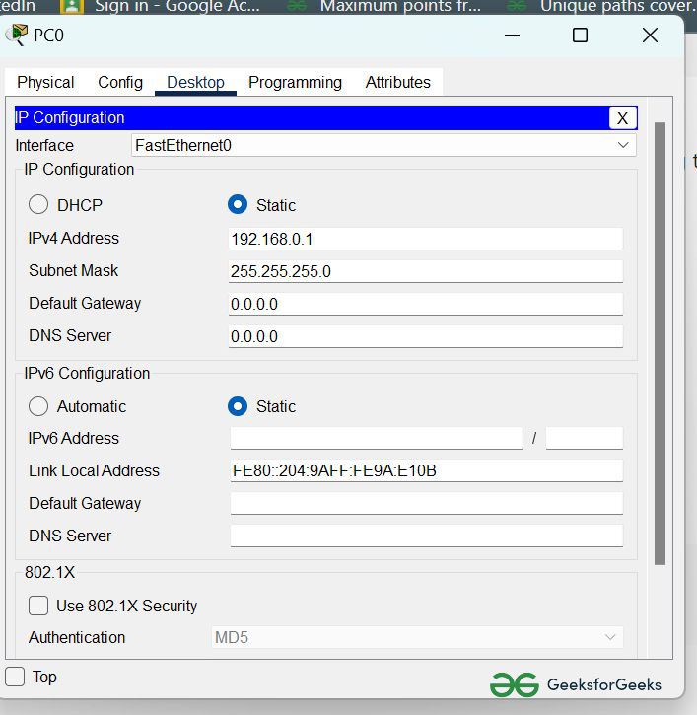
Assigning IP address using the ipconfig command.
Also, we can also assign an IP address with the help of a command.
Go to the command terminal of the PC.
Then, type ipconfig <IPv4 address><subnet mask><default gateway>(if needed)

Slide 4
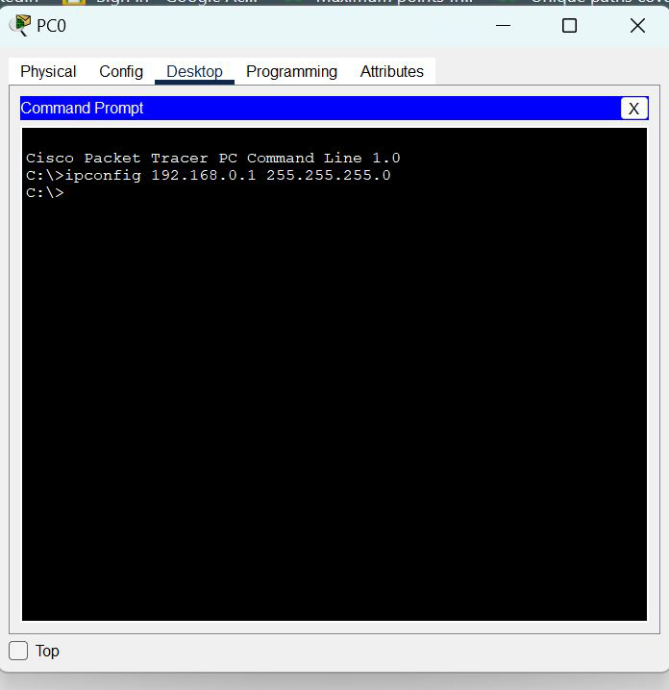
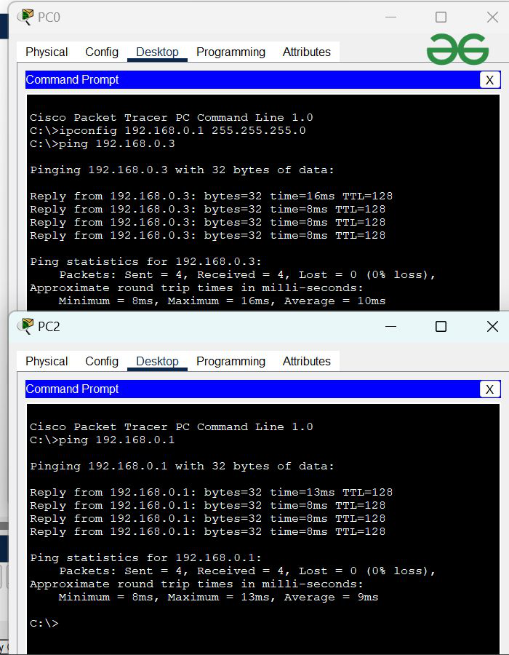
Step 3: Verify the connection by pinging the IP address of any host in PC0.
Use the ping command to verify the connection.
We will check if we are getting any replies or not.
Here we get replies from a targeted node on both PCs.
Hence the connection is verified.
A simulation of the experiment is given below we have sent two PDU packets one targeted from PC0 to PC3 and another targeted from PC1 to PC2.

Slide 5
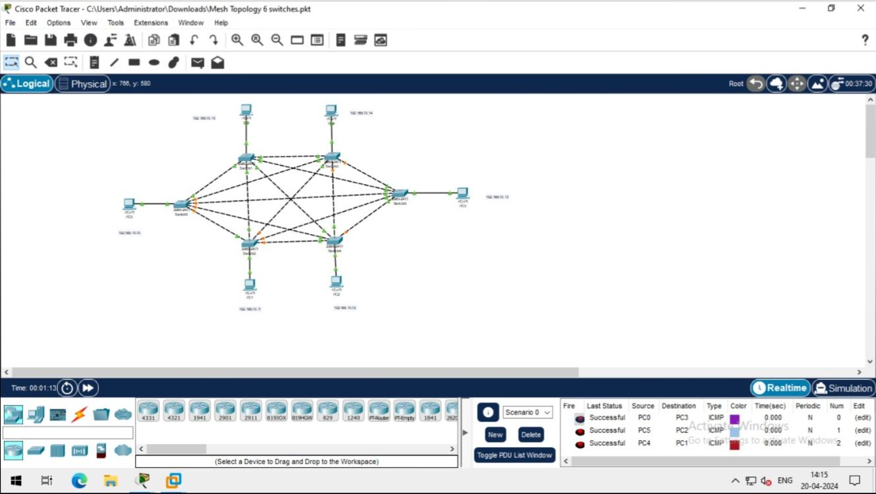
Now mesh topology is successful

